Slide 1


Mobile Supplier Management System
CS-261
Project Member (CS261F22FinalPID08)
Shahbaz Rafique 2021-CS-16
Saad Munir 2021-CS-19
Hammad Younas 2021-CS-20

Slide 2
Content
Project Introduction
Project Features
Technology & Stack
Project Actor
Use cases
User Interface
Object Oriented Features
Detailed Oriented Design
Data Storage
Email Sending
Analytical Reports

Slide 3
Project Description
Our Project is Mobile Supplier Management System. The Project is mainly for the distribution of the cell phones where the end user is shopkeeper. Manager have access to add employee, view employee, confirm rider, Add product, view all product and view the monthly report. Employee have access to add rider, view rider, view all product, Manage orders, track order and fuel management. Rider can Take order, view Assigned order , view route and view delivererd orders.

Slide 4
Project Features
Map
Rider can view the route on the map.
Email Sending on threshold quantity
Email was sent automatically to manager about the product which is less than the threshold quantity 10.

Slide 5




Technology & Stack
Language:
Python
IDEs:
Visual studio (VS) Code

Slide 6
Project Actor
There are three kind of actors in project
Manager
Employee
Rider

Slide 7
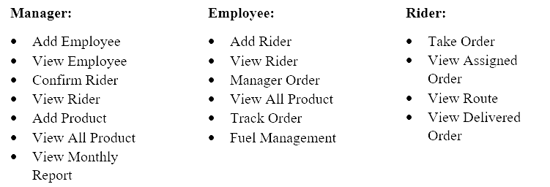
Use Cases

Slide 8
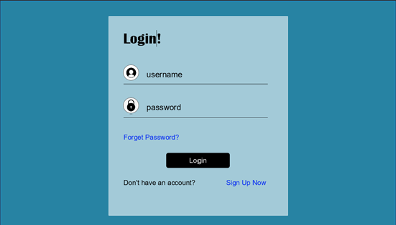
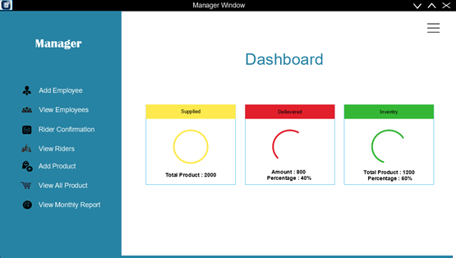
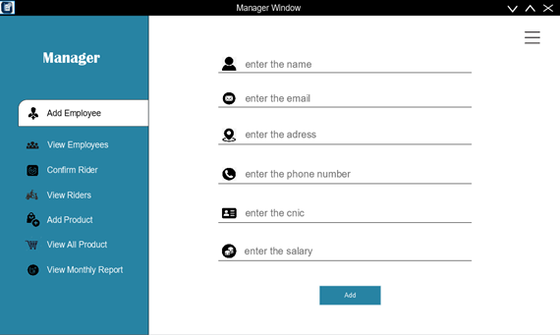
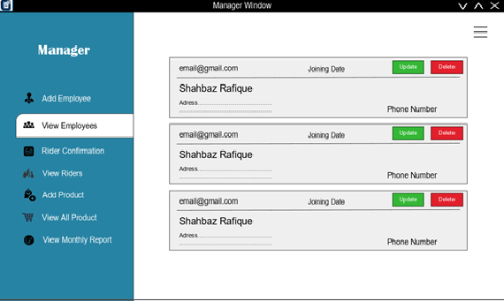
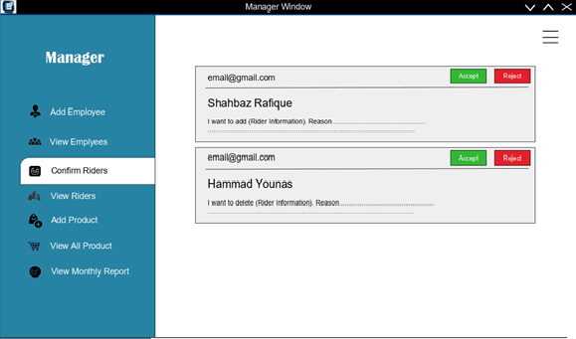
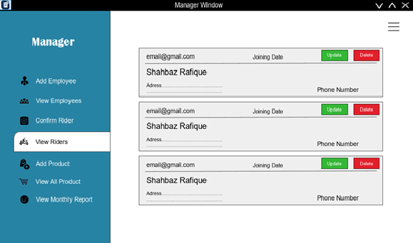
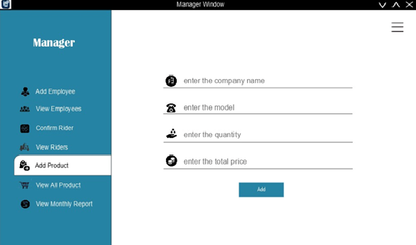
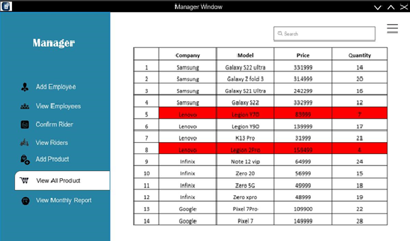
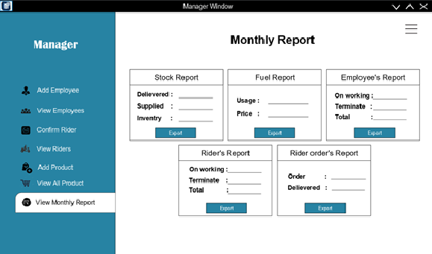
Use Interface (Manager)

Slide 9
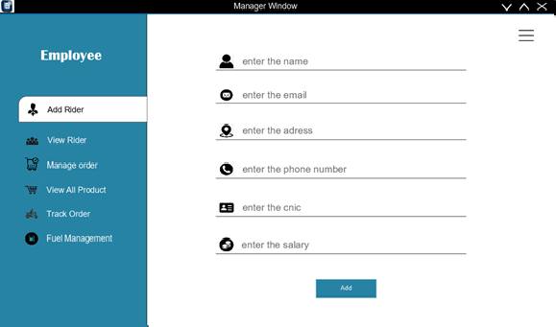
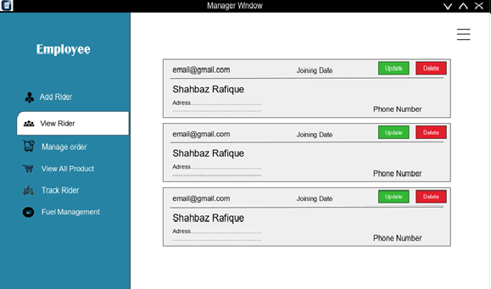
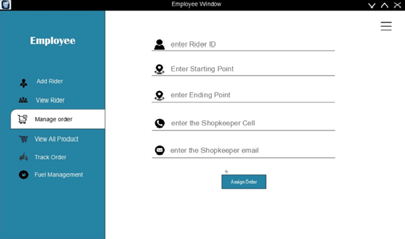
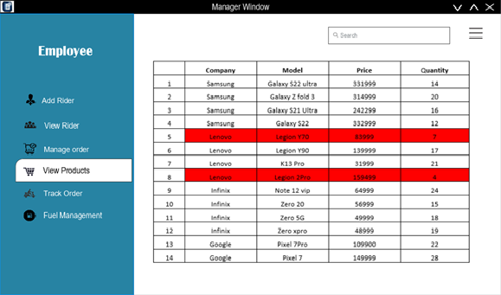
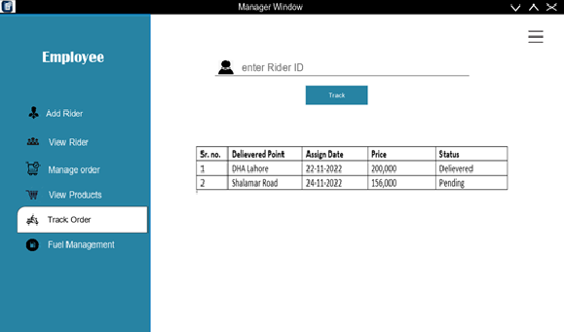
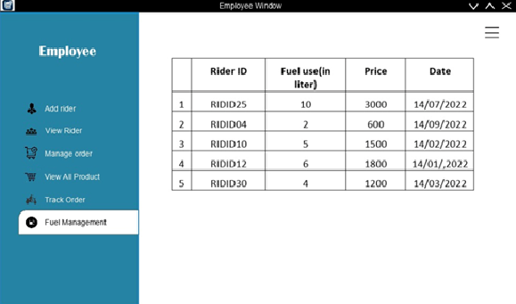
Use Interface (Employee)

Slide 10
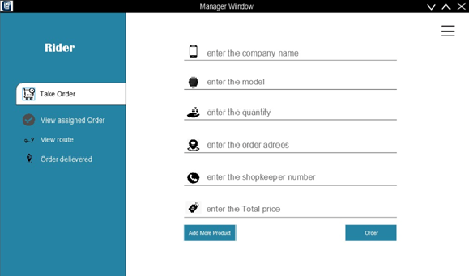
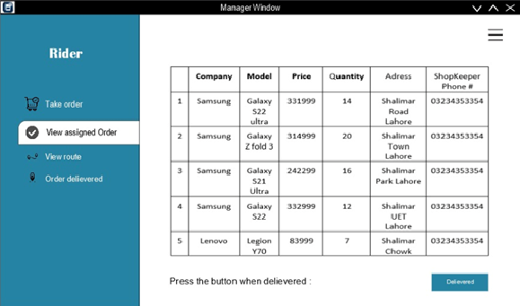
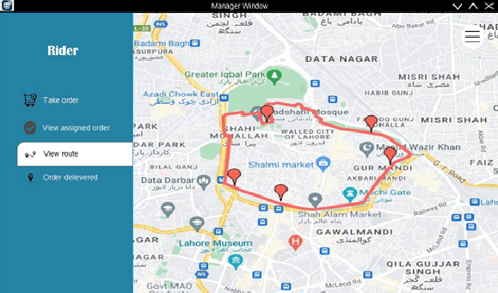
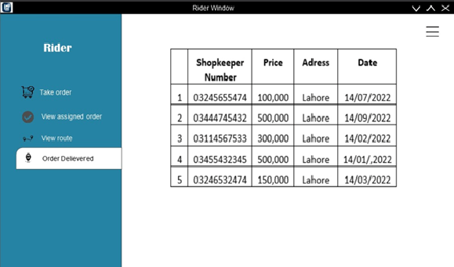
Use Interface (Rider)

Slide 11
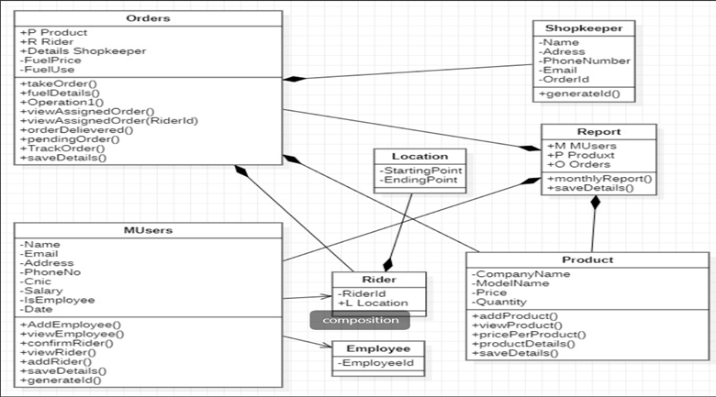
Object Oriented Features
Composition

Slide 12
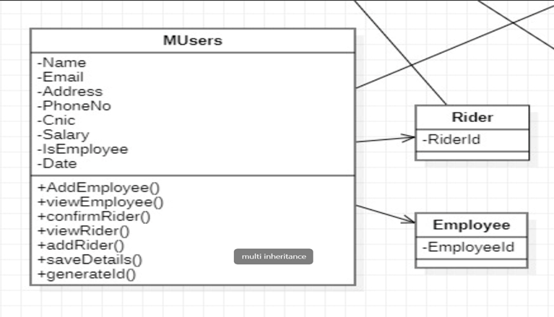
Inheritance

Slide 13
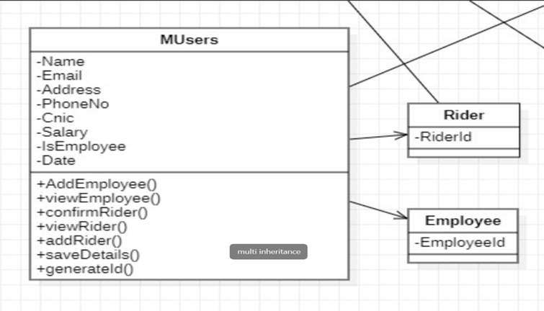
Multiple Inheritance

Slide 14
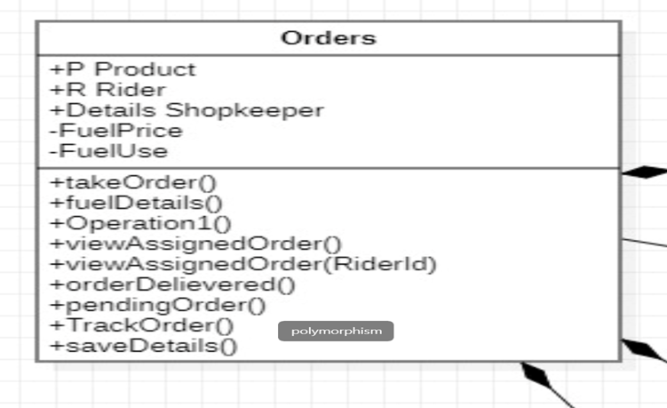
Polymorphism

Slide 15
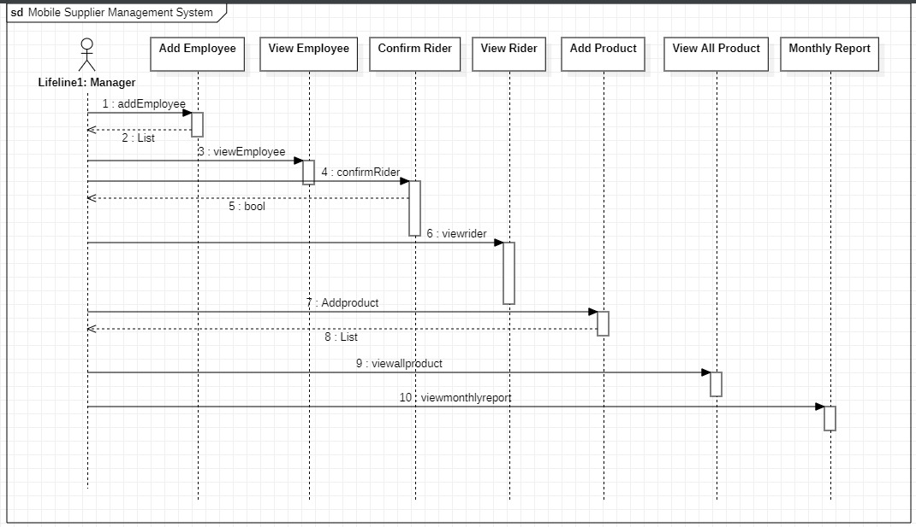
Detailed Oriented Design
Manager

Slide 16
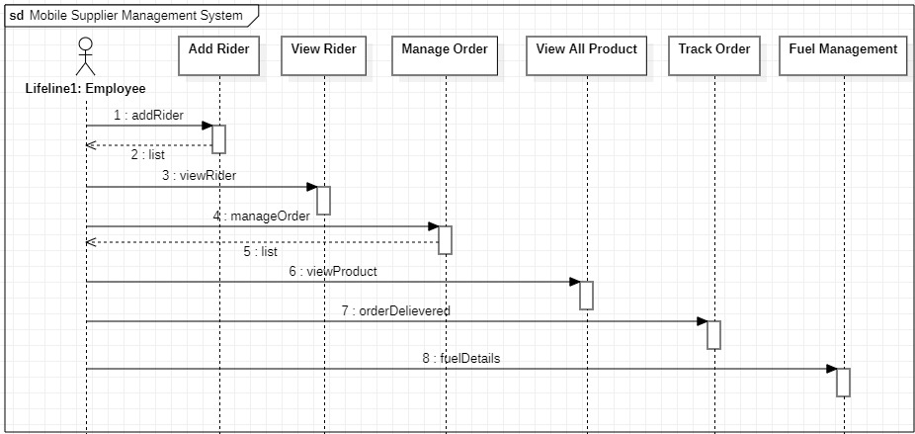
Employee

Slide 17
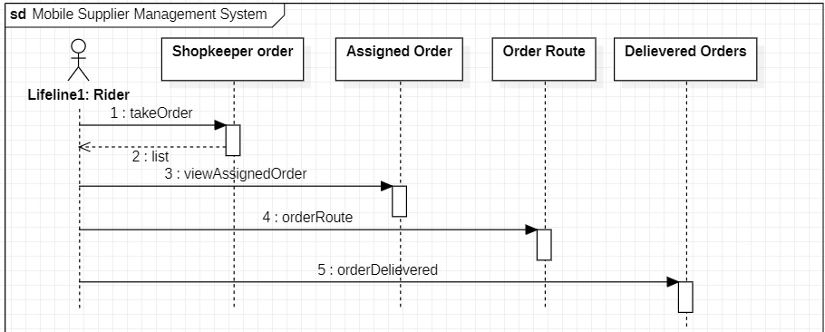
Rider

Slide 18
Data Storage
We store and read all data From CSV. We will make 10 CSV files.
Excel Files Name | Purpose
Employee.csv | For storing the details of Employee
AddProduct.csv | For storing the details of products
AddRider.csv | For storing the data of rider
ManageOrder.csv | For storing the data of orders and rider
TakeOrder.csv | for storing data of order
StockReport.csv | For Stock report
FuelReport.csv | For Fuel Report
RiderOrder.csv | For Rider Order Report
RidersReport.csv | For Rider Report
EmployeesReport.csv | For Employee Report

Slide 19

Email Sending
When Manager add or delete Employee email was sent to employee, when employee add or delete rider email was sent to manager for confirmation after that if manager accept email was sent to rider. When Order was assigned to rider email will sent to rider. After order delivered email was sent to employee.

Slide 20
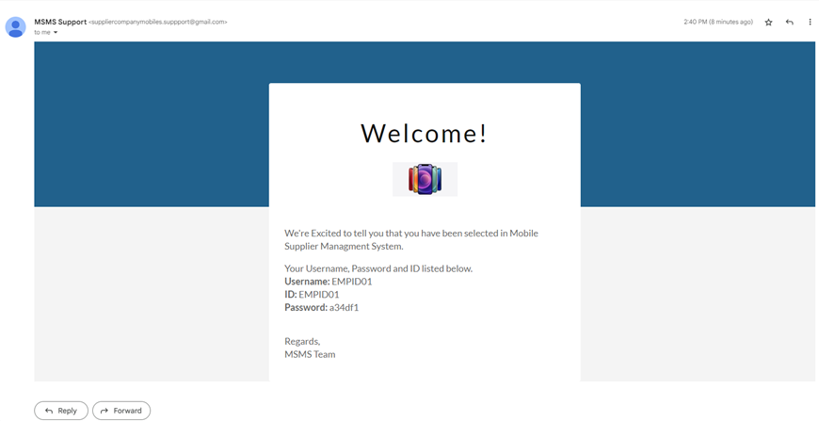
Email Template

Slide 21

Analytical Reports
We Generate 5 types of the analytical report. Stock report, Fuel Report, Rider Order Report, Employees Report and Riders Report. All the reports are in the form of CSV files. Manager can Download all these CSV files from view Monthly Report Section.

Slide 22
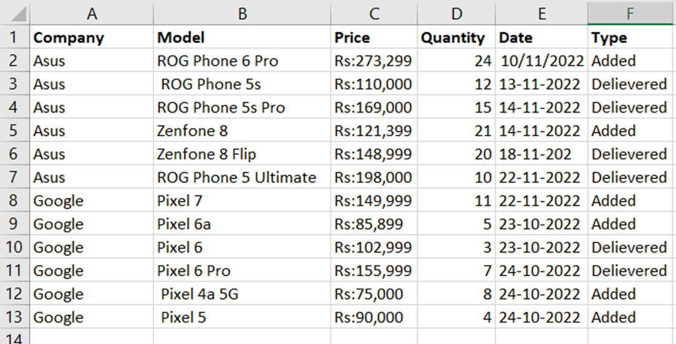
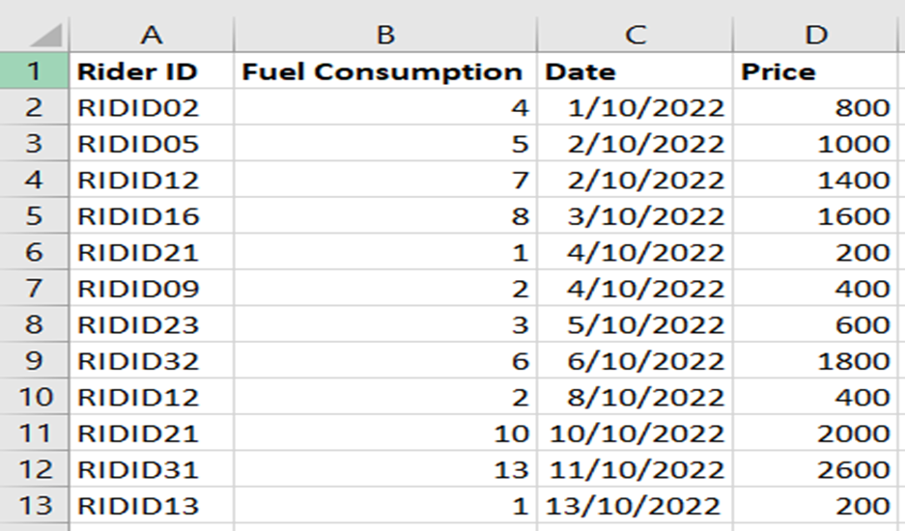
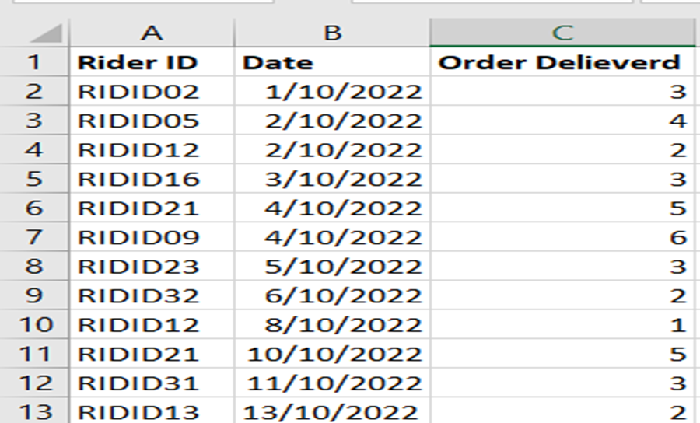
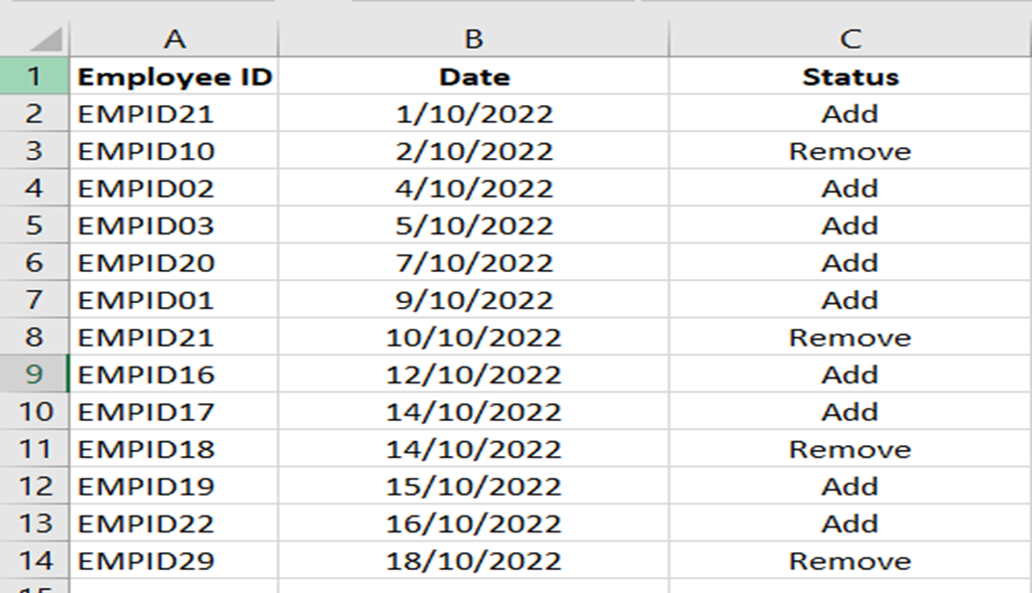
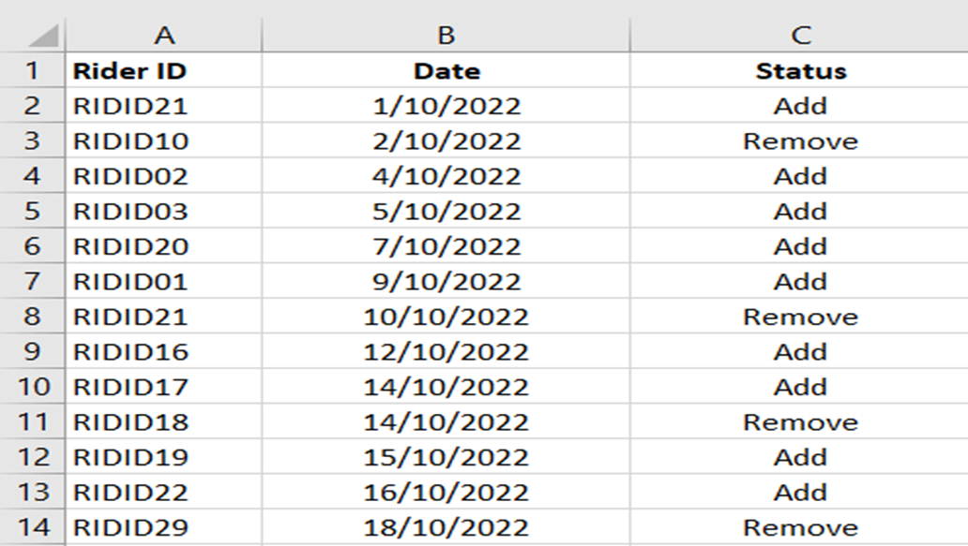
Stock Report
Fuel Consumption
Rider Order Report
Employee Report
Rider Report

